Slide 1

CAPSTONE PROJECT REVIEW I Customer Churn Prediction using ANN
Name : Tushar Maurya
Register No:19BCE1856
Programme & Specialization : B.Tech CSE
Guide Name:
Dr. K. Sathyarajasekaran

Slide 2
Outline
Introduction
Problem Statement
Research Challenges
Research Objective
Proposed System
What is to be done next/for review 3
Research Paper Status
Guide Approval mail snapshot
References

Slide 3
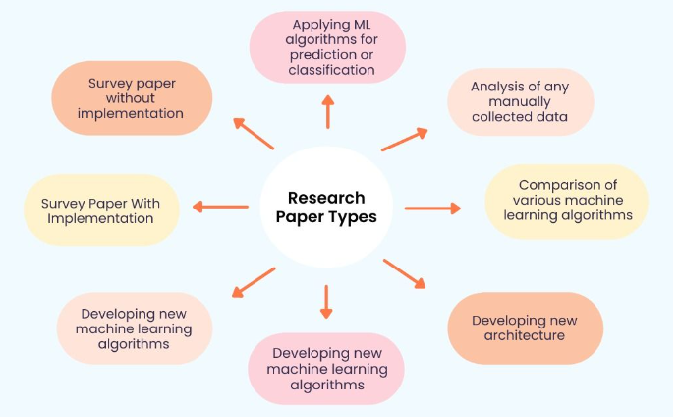

Slide 4
Introduction
Businesses around the world are evolving every day which has drastically led to the growth of two major fields Artificial intelligence and Machine Learning.
Technology based on AI and ML has recently developed to such an extent that it has become an essential element of the largest online stores on the web.
Most of the work in the online store is automized.

Slide 5
Other fields where ML and AI have achieved excellence:-
Speech recognition(Voice search, appliance control, Alexa Home, Google Home)
Virtual Assistant(Alexa, Siri)
Image recognition(facial, non-living things)
Google Translation(Language translation)
Traffic Alerts in Google Maps
Self-driving cars(Waymo)
Medical diagnosis
Predictive analytics(Loan prediction, SIP amount prediction)
Recommender System(Music and movie Recommendations)

Slide 6
Problem Statement
I have seen many Research papers and I found that much research work has been done in the field but still there is much more left.
Many companies have a weak working algorithm which sometimes affects their sales and they don’t even exactly know how many customers stopped buying from their website.
So, I have decided to work on the churn Prediction and not only that try including the dataset of other companies so that you don’t make a mistake. It’s true that you learn from your mistake but if others are making mistakes why not learn from them?

Slide 7
Research Challenges
I faced many issues as most of the Research papers in this field are to predict Telecommunication customer churn, so whenever I searched for E-commerce, it was very tough to find.
Companies like Dunnsolution have made the E-commerce world a competitive market as they are specially providing their services in this field to have all sorts of models.

Slide 8
Research objectives
My main research objective is to find an ANN solution for the given problem in an optimized manner because I tried to find the Research paper’s Future Work in many of them it was mentioned the Deep Learning approach with Hyperparameter tuning. So, this approach can further lead to an optimized approach in this field.
I will also try if it is possible to compare many other algorithms. In K-fold methods.

Slide 9
Proposed Algorithm
Introduction-
It is based on brain function and is used to model complicated patterns and forecast issues. The ANN is a Deep learning method that replicates the working of the human brain. It accepts only numeric and structured data. So, we will be cleaning the data and bringing it down to the simpler form, and feeding it to the multi-layer model that we will be creating.
We will try to get the best possible result and later on use any gradient booster.

Slide 10
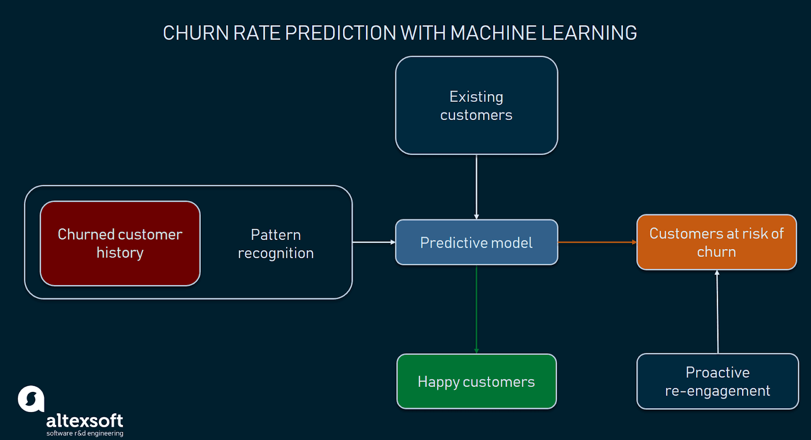
Diagram-

Slide 11
Modules-
Importing libraries
Exploratory Data Analysis[EDA]
Data cleaning
Dividing dataset into train and test
Creation of Model
Testing the model
Plotting the Accuracy

Slide 12
Explanation of Modules-
Importing libraries – Import libraries such as pandas, NumPy, matplotlib, seaborn, scikit-learn, and TensorFlow.
Exploratory Data Analysis[EDA] – Performing EDA on the dataset so that we can have a better understanding of the dataset like seeing the ratio of churn on the basis of gender, the device used for ordering, payment method, etc.
Data cleaning – As the dataset has different problems in them. Some of them are
Dividing dataset into train and test- Using scikit learn we will be dividing the dataset into two parts: Train(80%) and Test(20%).

Slide 13
Creation of Model – We can create the model using all the columns and simply by adding one extra dense layer of neural network and using 100 epchos.
Testing the model – Testing the model to see its accuracy with fewer epochs values and slowly increasing when getting a linear increment in values.
Plotting the Accuracy – Plotting the accuracy on the heat maps to get when I am getting the correct( yes and no) and when incorrect(yes and no).

Slide 14
Work to be Completed(What is to do be done in Review 3)
I have not written much in the research paper as most of the time went into understanding the Dataset while performing EDA and data cleaning.
Most of my time went into thinking of another Algorithm and trying to proceed with it was getting harder.
As some of the approaches give better results with more space utilization and vice versa.

Slide 15
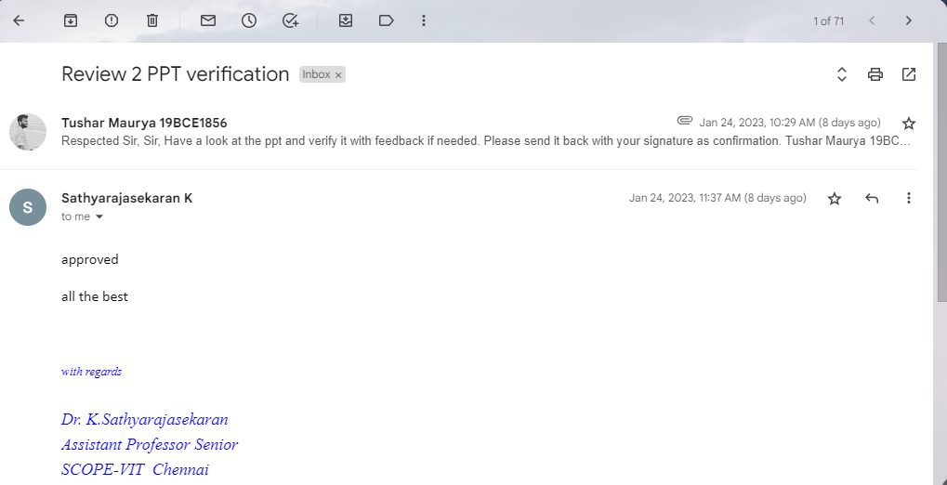
Guide Approval Snapshot

Slide 16
Any other additional information to be added by Guide
No, There is no additional information to be added by the Guide. My guide is very helpful, I already knew that as I studied TOC one of the toughest theoretical subjects under him and he helped me a lot even at that time. Even in the times of Covid-19, he delivered his best using a whiteboard at home. So, I thought to work under his supervision.
My idea was accepted after writing a mail to the guide and explaining everything on call.

Slide 17
References ( Same order as Literature Review)
The Impact of Customer Satisfaction and Relationship Quality on Customer Retention: A Critical Reassessment and Model Development [1997]
Thorsten Hennig-Thurau and Alexander Klee (University of Hanover)
Churn Prediction: Does Technology Matter? [2006]
John Hadden, Ashutosh Tiwari, Rajkumar Roy, and Dymitr Ruta
Scikit-learn: Machine Learning in Python [2012]
Fabian Pedregosa, Gaël Varoquaux, Alexandre Gramfort, Vincent Michel, Bertrand Thirion, Olivier Grisel, Mathieu Blondel, Peter Prettenhofer, Ron Weiss, Vincent Dubourg, et al

Slide 18
Customer Churn Prediction in Telecommunication A Decade Review and Classification [2013]
Nabgha Hashmi ,Naveed Anwer Butt and Dr.Muddesar Iqbal
An Integrated Framework to Recommend Personalized Retention Actions to Control B2C E-Commerce Customer Churn [2015]
Shini Renjith
Predicting Shipping Time with Machine Learning. [2015]
Antoine Jonquais, Florian Krempl Advisor, Dr. Roar Adland, Dr. Haiying Jia
LightGBM: A Highly Efficient Gradient Boosting Decision Tree [2017]
Guolin Ke , Qi Meng , Thomas Finley , Taifeng Wang , Wei Chen , Weidong Ma , Qiwei Ye , Tie-Yan Liu

Slide 19
Customer Lifetime Value Prediction Using Embeddings [2017]
Benjamin Paul Chamberlain, Angelo Cardoso, C.H. Bryan Liu, Roberto Pagliari, Marc Peter Deisenroth
Introduction to artificial neural networks [2018]
Enzo Grossi , Massimo Buscema
Online Fashion Commerce: Modelling Customer Promise Date [2021]
Preethi V, Nachiappan Sundaram, Ravindra Babu Tallamraju

Slide 20
Thank You

